Slide 1

Task 4
EDA PROJECT
AMCAT Data Analysis
Name: Mohammad Wasiq
Intern ID: IN1240273
E-mail: gl0427@myamu.ac.in

Slide 2
Problem Statement
The dataset was released by Aspiring Minds from the Aspiring Mind Employment Outcome 2015 (AMEO). The study is primarily limited only to students with engineering disciplines. The dataset contains the employment outcomes of engineering graduates as dependent variables (Salary, Job Titles, and Job Locations) along with the standardized scores from three different areas – cognitive skills, technical skills and personality skills. The dataset also contains demographic features. The dataset contains around 40 independent variables and 4000 data points. The independent variables are both continuous and categorical in nature. The dataset contains a unique identifier for each candidate. Below mentioned table contains the details for the original dataset.

Slide 3
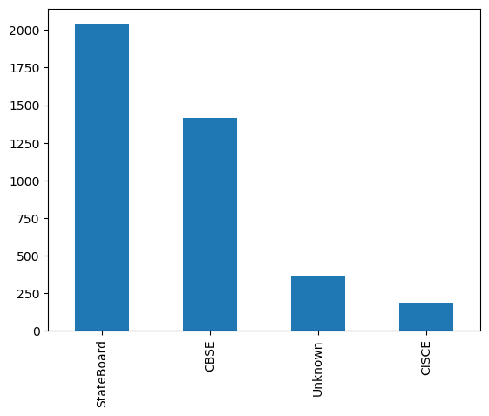
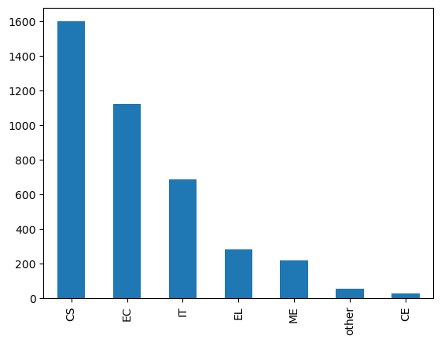
12th Board Students
Top 10 Specialization Courses
From the above bar graph we can say that the people who got placed are from Computer Science background which are 1601 and then from Electronics Communication background which are 1123.
According to our data we can conclude that there is a high demand of Computer Science Engineers in the market.
According to our data we can easily say that State Board and CBSE Board students are doing well and got placed as compare to others.

Slide 4
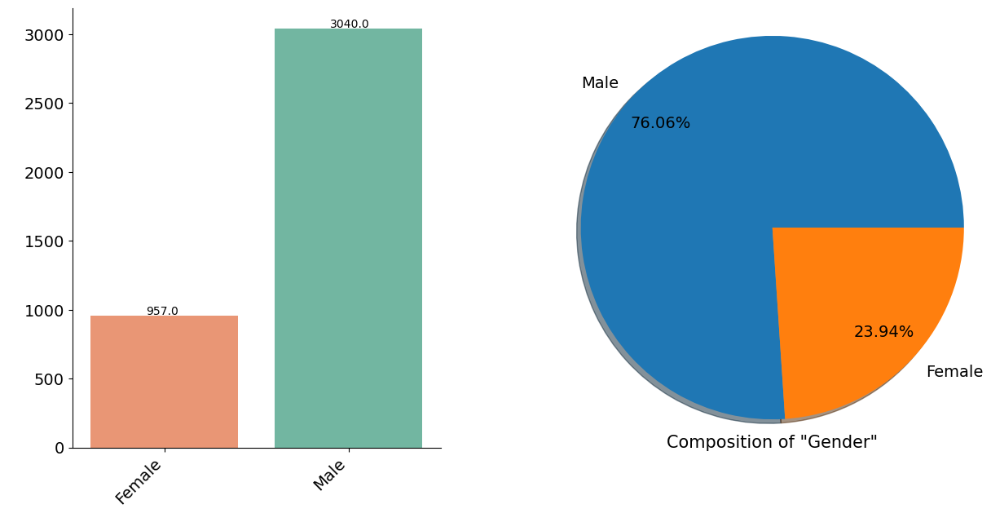
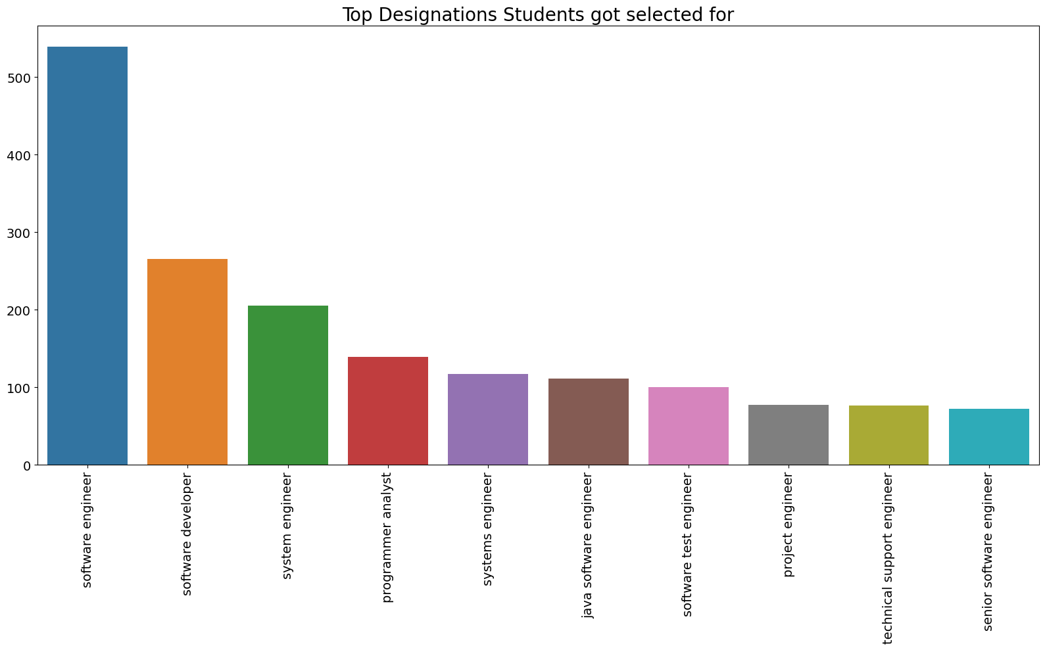
Gender
Top Designations Students
Got Selected
According to bar plot and pie chart we can say that there are 3040 Males which is about 76% and there are 957 Females which is about 24% working.
According to our dataset we can say that Males are more hired as compare to females. Which is not a good thing because it violate the Gender Equality, which is highly promoted by our Government.
According to above bar graph we can easily say that most of the students got placed as Software Engineer, Software Developer and System Engineer.
We can conclude that there is a high hiring as Software Engineer, Software Developer and System Engineer.

Slide 5
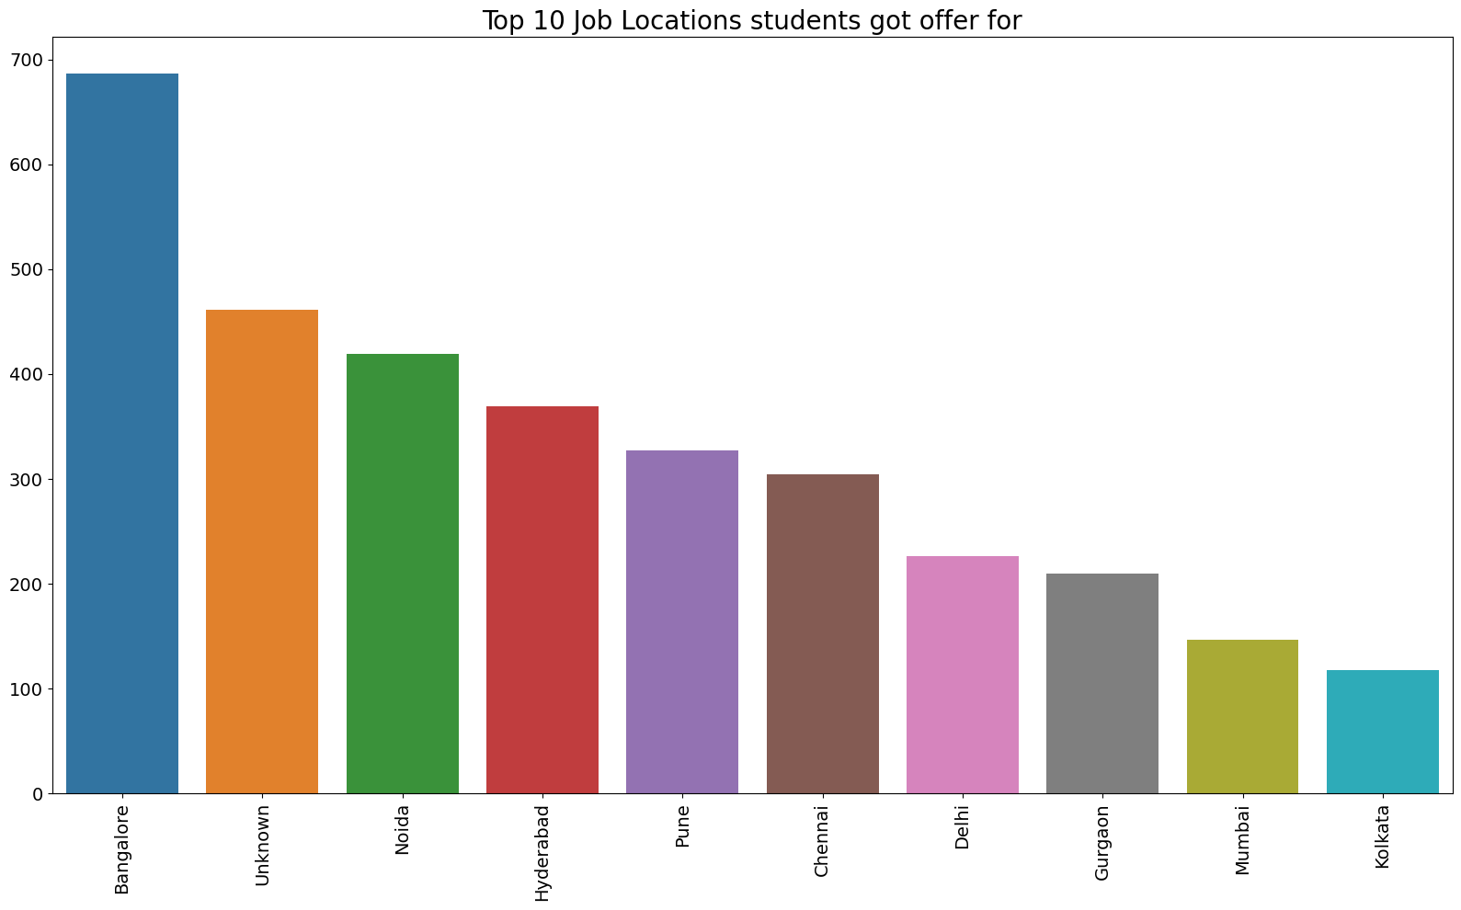
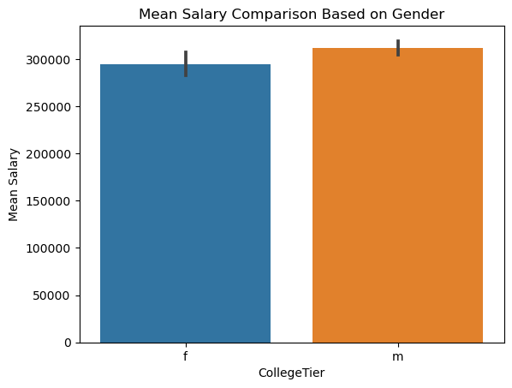
Top 10 Job Locations Students Got Offer
Gender-wise Average Salary
According to above bar graph we can easily say that most of the students got placed at Bangalore, Noida and Hyderabad cities.
We can conclude that Bangalore, Noida and Hyderabad are best cities for Job market in IT Industry.
According to above bar graph we can easily say that Male got the higher salary than Female.

Slide 6
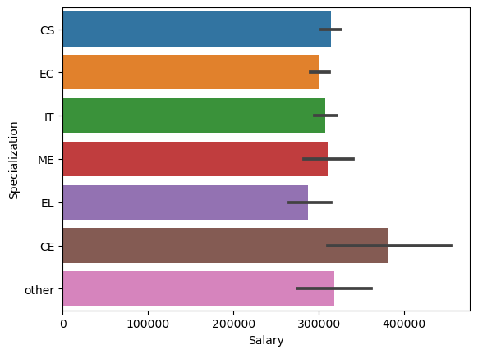
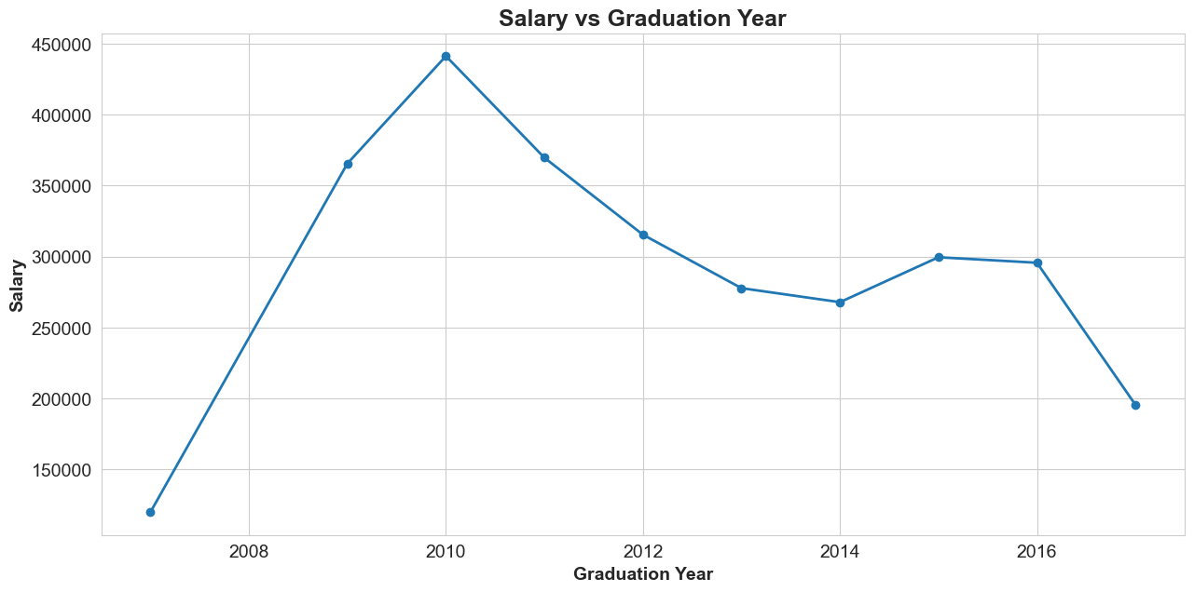
Salary Based on Specialization
Salary Based on Graduation Year
According to the plot, salaries for students who graduated between 2007 and 2010 increased steadily.
The salary then decreases until 2014 and increases until 2015, respectively and then again decreases for year 2016 and 2017.
There has been a steep decrease in average salary from year 2016 to 2017.
According to above bar graph we can easily say that most of the CE students got highest salary.

Slide 7
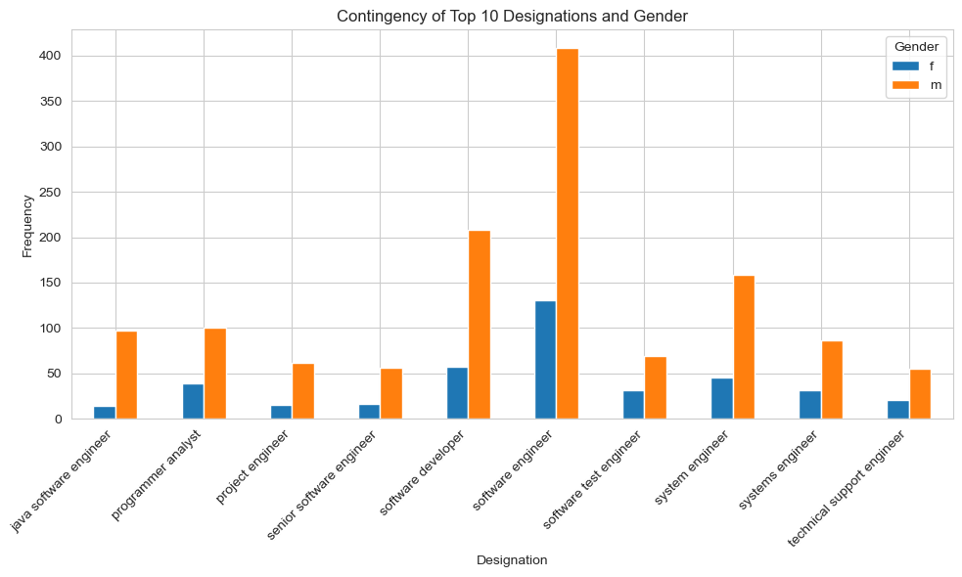
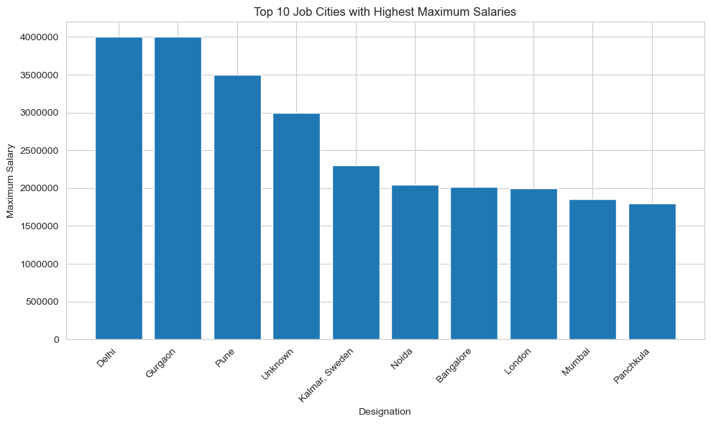
Cities with the Highest Salary
Top 10 Designations base on Gender
According to above bar graph we can easily say that Software Engineer have the higher chance to got placed for Men and Women as well.
According to above bar graph we can easily say that Delhi, Gurgaon gives the most salary as compare to other cities.

Slide 8
THANK YOU

